Slide 1
Automation of Deception Based Security System
Presented by
Mohammad Arshad Pulikkal
Network and Computer security department
SUNY Polytechnic institute

Slide 2
Outline
Current cybersecurity system
Deception based security
Automation for better performance
Implementation
Limitations
Conclusion
Notes:
Cut the bullet points 4 or 5

Slide 3
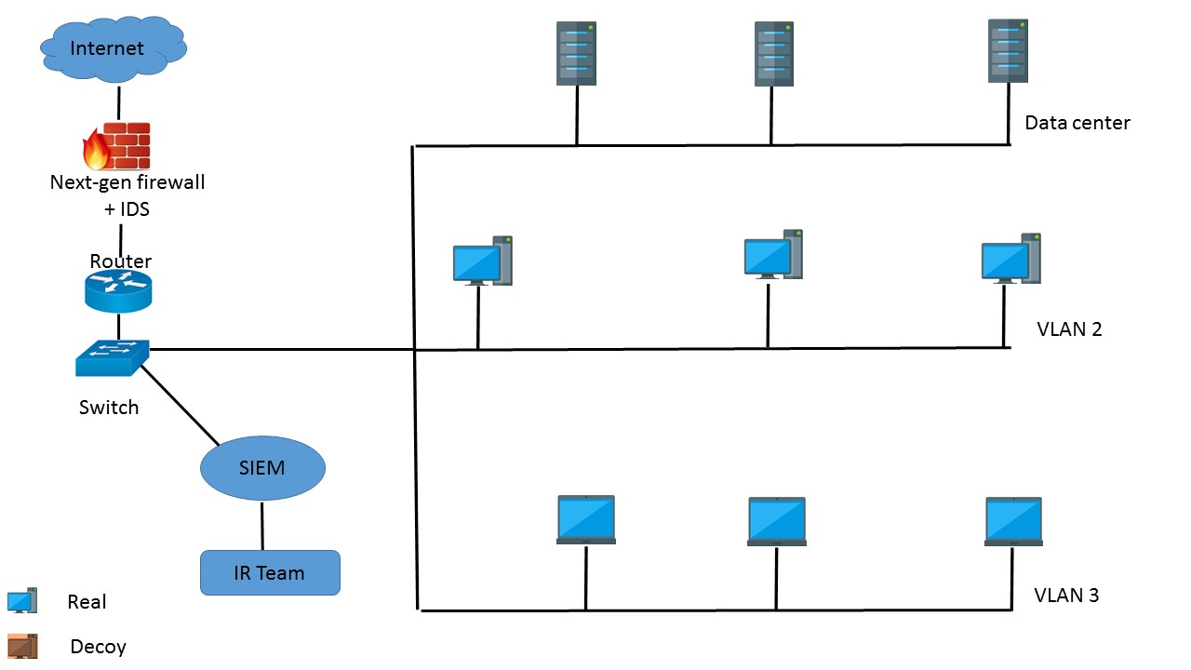
Current Cybersecurity system
Notes:
Background – network security

Slide 4
Next-gen firewall filters the packet using deep packet inspection.
IDS checks for malicious content based on signature and anomaly.
SIEM provides real-time analysis of network and security incidents.
Incident Response team are the people who further analyze the security incident and provide response.

Slide 5
Still falls short
Security breaches are occurring in fast pace than before.
Zero day attacks cannot be mitigated.
Generates lots of false negative and false positive, which can confuse the IR team and miss the real incident.

Slide 6
Deception technology
Deception is making someone believe something that is not true in order to defend the target environment.
We deploy machines known as decoys along with real assets.
Decoys are machines which looks real and no more vulnerabilities than real device.
Decoys are deployed with real OS, real application, fake data and fake activity.
Notes:
Asymmetry in background

Slide 7
Intrusion onto a decoy machine is more likely.
Any activity on the decoy devices indicates a security breach as no legitimate activities are performed on a decoy.
No false positives and false negatives. Every security incident will be a 100% true positive.
Probability of overcoming a zero-day attack is more in deception based system.
Alert from decoy machines can be used for analysing the vulnerability and exploit. Thus we can secure the real assets before the attack happens.
Notes:
Define decoys – what is decoy?
Remove every way.

Slide 8
Manual implementation
Deploy each decoy servers and hosts by hand
Create virtual machines, install operating system.
Enable system services and open ports.
Upload fake data such as:
User credentials
Web pages
Database
User files

Slide 9
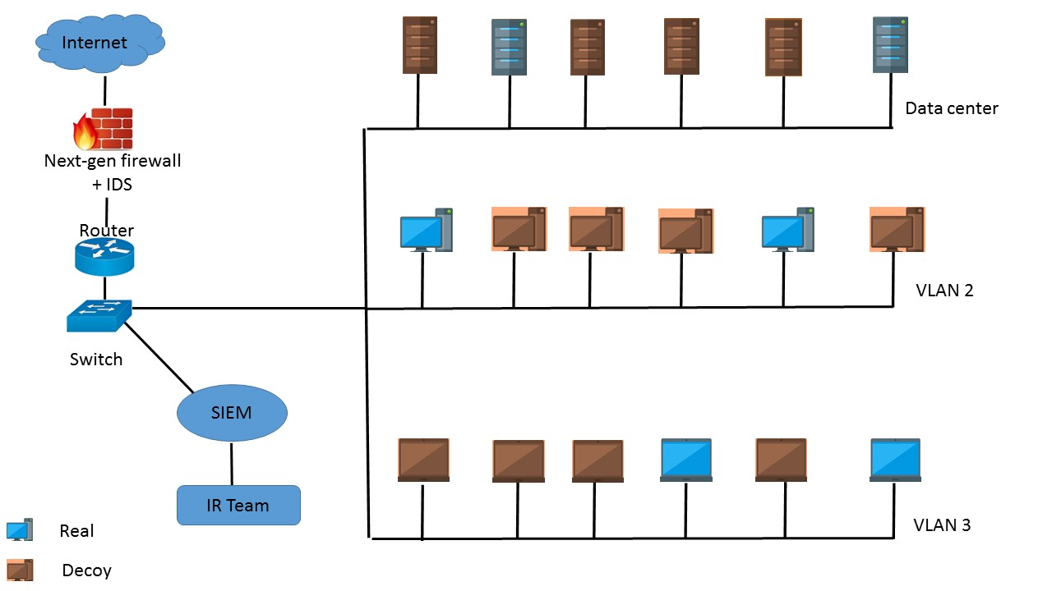
Deception based network

Slide 10
Complexity of network increases as IoT and BYOD are implemented.
Dynamic changes in network increases as new devices and services are regularly implemented
Creating a accurate deception environment manually will be challenging.
Our goal is to automate the deployment of decoys which can be revised periodically.

Slide 11
Automation of deploying decoys
From the existing system, we collect data which can be used for automating the process of deploying decoys.
SIEM provides us log data such as: host logs, server logs, netflow logs and security alerts.
We need more data like operating system, open ports, services running, for that we use network scanning.
Fake data has to be created by analysing the existing data.
Notes:
Mention the colors

Slide 12
Architecture
A
S
S
E
T
S
SIEM data
Splunk CSV
Playbook
YAML
Ansible
Netscan data
Nmap XML
Python code for converting to CSV
Text, HTML, CSV etc
Fake content

Slide 13
We collect data from the real devices.
Splunk - used to aggregate the logs and correlate the events of real devices.
Nmap - used to identify the services running on the hosts, state of ports and the operating system of the devices in the network.

Slide 14
We convert data into CSV format
Splunk stores data in CSV format.
Nmap scan is in XML format and fake contents can be in different formats depending on the usage.
Easy to fetch data from CSV and provide input to playbook.
We use a python code for the conversion.

Slide 15
Ansible automation software is used to create decoy virtual machines.
Data are supplied to ansible through a YAML file known as playbook.
Modify the YAML file according to our requirement.
Decoys are stored in Vmware ESXi server.

Slide 16
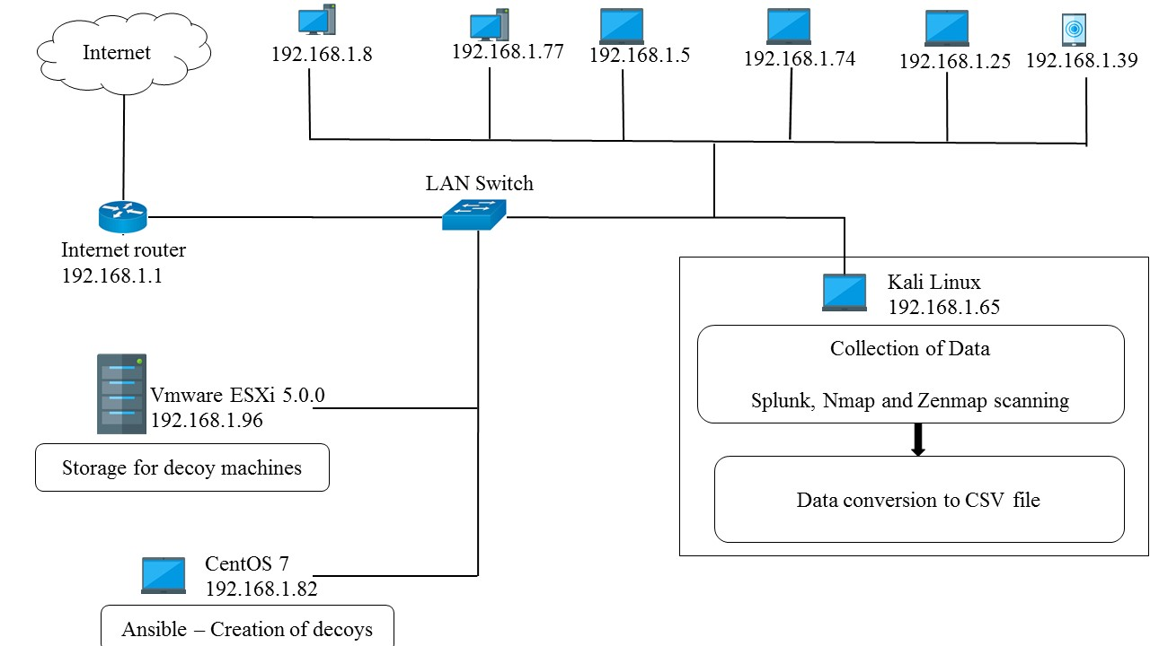
Implementation

Slide 17
Implementation
6 host device with different flavours of OS.
1 host with kali Linux for collecting data and converting to CSV file.
1 host with CentOS 7, which have Ansible automation software for creating decoy machines.
1 server installed with Vmware ESXi 5.0.0, where the decoy machines are stored.
All the devices are interconnected through a switch.

Slide 18
Splunk
Splunk is installed in kali Linux host.
Collect event logs from router, switch and the hosts.
Source IP address, destination IP address, time of event, destination ports, number of packets, size of packet and the flags are extracted from event logs.
This parameters are converted into CSV file in splunk itself.

Slide 19
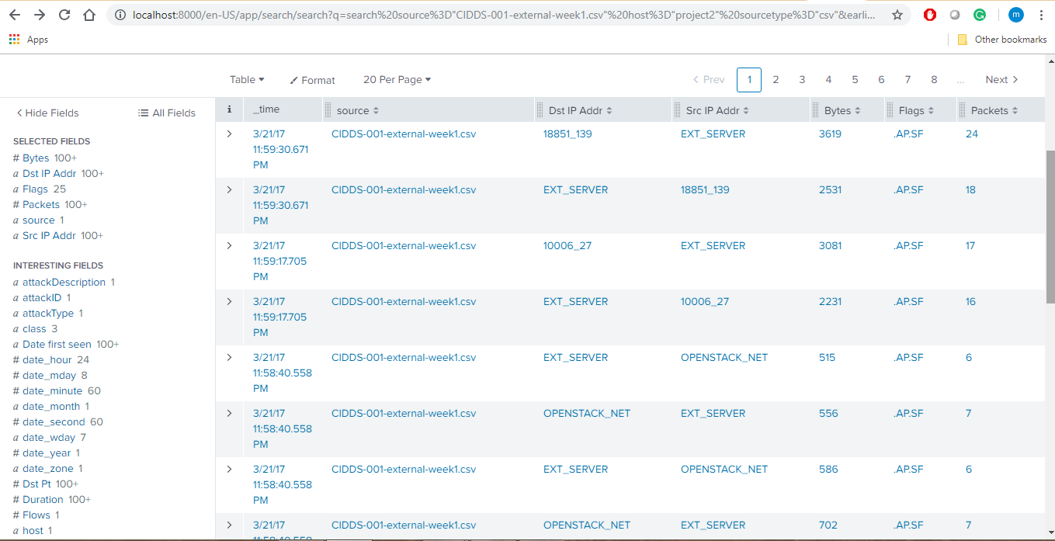
Fig: Splunk working

Slide 20
Nmap scanning
Nmap is used to identify the services running on the hosts, state of ports and the operating system of the devices in the network.
“nmap –sV –O –v 192.168.1.0/24 –oX Project1.xml”
Output is stored in XML format.

Slide 21
Nmap scan to CSV file code
Main()
Parse_xml(filename)
Get_host_data(root)
4
5
Parse_to_csv(data)
1
Opens csv file
2
csv_writer()
Writes data from list to csv file
3
Creates list of hosts which are up
list is then iterated to write the host data row-wise into the csv file
Retrieve and add IP, Port and OS
csv file is closed

Slide 22
Ansible
Ansible is installed on a CentOS 7 host.
Connect to Vmware server using SSH and pull configuration using ansible modules.
Prerequisites are python version 2.6 or greater and pysphere.

Slide 23
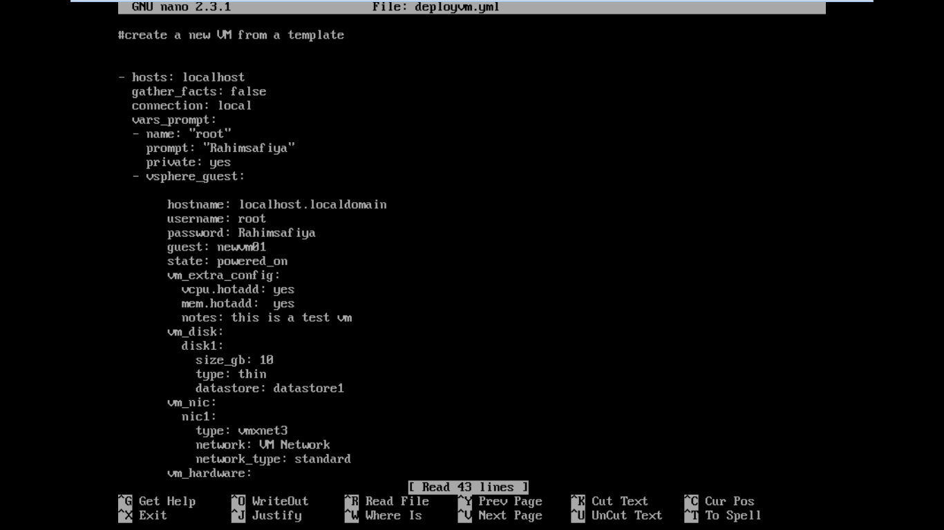
Fig: YAML file

Slide 24
Vmware ESXi 5.0.0
Server where decoy machines are deployed.
Type1 hypervisor
Administered through vsphere client.
we have to upload the operating system for the decoy machines into data storage of server.
The YAML file will point this location as the path for the operating system.

Slide 25
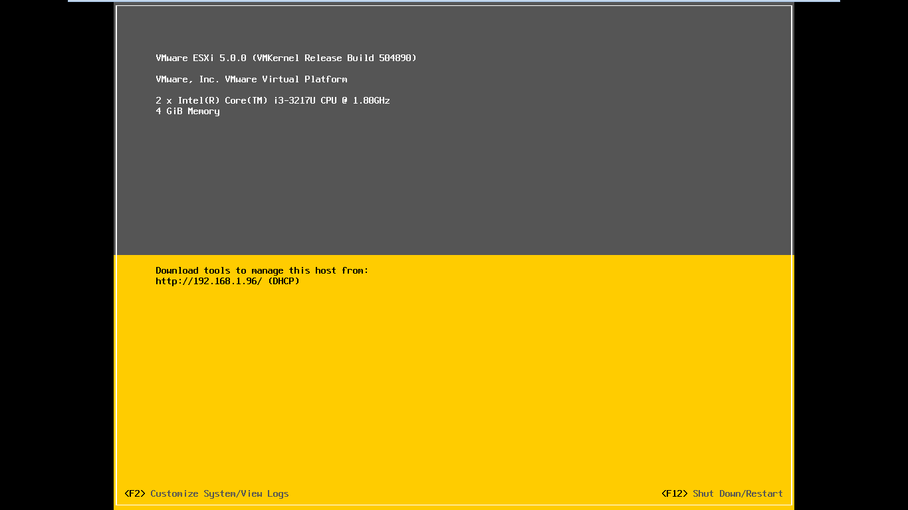
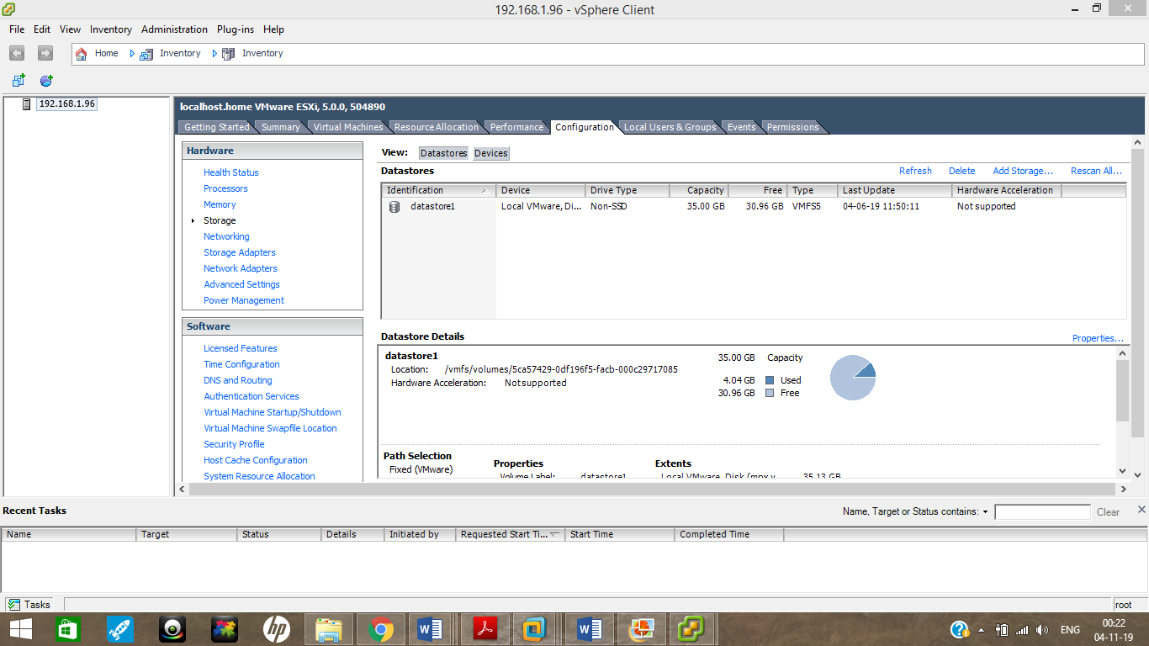
Fig: VMware ESXi interface
Fig: vSphere client

Slide 26
Future research
Fetching data from CSV file to playbook.
Collecting data from real device and generating fake contents.
Generating fake traffics.

Slide 27
Conclusion
Goal of this research is to develop an automated decoy deploying system to increase the scalability of deception based security system.
It will increase the accuracy of detecting an attack and reducing the false positives and false negatives.
Deception technology should be used along with other existing methods to increase the security.

Slide 28
References
“ICO fines Equifax for 2017 customer data breach,” CisoMag, Septmeber 24, 2018. [online] Avaialble: https://www.cisomag.com/ico-fines-equifaxover2017-customer-data-breach/. [Accessed: October 12, 2018]
“How Deception Technology Gives You The Upper Hand In Cybersecurity” Forbes, June 22, 2018. [online] Available: https://www.forbes.com/sites/danwoods/2018/06/22/how-deception-technology-gives-you-the-upper-hand-in-cybersecurity/#4e7bb95d689e/. [Accessed: September 15, 2018]
'Niccolò Machiavelli', Wikiquote, October 10, 2018, [online] Avaialble: https://en.wikiquote.org/wiki/NiccolC3B2_Machiavelli/. [Accessed 11 December 2018]
Gily Netzer, “8 Reasons Why Deception Technology Trumps Honeypots Every Time,” May 25, 2017. [online] Available: https://blog.illusivenetworks.com/8-differences-between-honeypots-and-deception-technology. [Accessed: October 2, 2019].
“Definitive guide to deception 2.0,” Acalvio Technologies, 2017.

